Slide 1
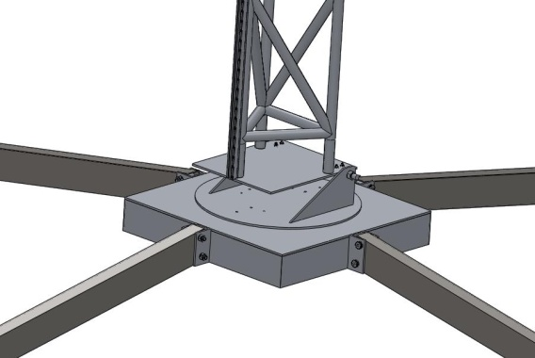


A New Launcher for University Sounding Rockets
Fernando Calderon, Abd Al Chamas,Thomas Wilson,
Adam Vore & Berton Vite
Department of Mechanical and Aerospace Engineering
California State University Long Beach

Slide 2
Agenda
ESRA & IREC
Requirements
General Mechanical Arrangement
Angular Adjustments
Electrical Subsystem
Summary & Recommendations

Slide 3
Experimental Sounding Rocket Association’s
Intercollegiate Rocket Engineering Competition
How closely their rocket approaches its target apogee. The competition has two classes, Basic (target apogee is 10,000 ft) and Advanced (target apogee is 25, 000 ft). Apogee is determined by a recording altimeter. A payload weighing at least 10 lbs must be flown.
Whether or not their rocket was recovered intact and returned to the launch site within 2 hours of launch. Recovery is by student teams on foot searching the high desert environment near Green River, UT, in the summer. Walky-talkies and water are very important.
The quality of the data returned by the payload.
A Safety Report must be prepared, and its quality judged.
An Engineering Summary Report describing the rocket and its payload must be prepared, and its quality judged.
Written procedures must used to prepare and launch the rocket, and their quality will be judged.

Slide 4
Mechanical Subsystem Functional Requirements
Transportable using “U-Haul” trailer or similar size and shape
Ability to assemble and erect at the launch site using only manual labor & hand tools within a reasonable time frame.
Ability to rotate about both Azimuth & Elevation axes independently
Ability to level launcher platform to align Azimuth axis to the local vertical
Have a zero tip off rail-lug combination
Ability to replace the blast plate as needed
Provide support to the electrical subsystem
Ability to tilt the rail down to load the rocket without tipping over the launcher

Slide 5
Mechanical Subsystem Performance Requirements
Elevation angle range: – 5 degrees to + 95 degrees
Azimuth angle range: 0 degree to 360 degrees
Ability to control both Elevation & Azimuth Angles: ± 0.5 degree
Maximum launcher length while holding maximum bending deflection of the rail: 0.05 degree at a Quadrant Elevation of 80º
Max rocket weight: 150 lbs (carried by launch lugs)
Structural Margin of Safety: 3

Slide 6
Environmental & Electrical Requirements
Environmental Requirements
  Dry Sandy Soil California Bearing Ratio (CBR) > 6
  Maximum ground slope: 5 degrees
  Corrosion resistant coatings in marine environments
Electrical Subsystem Requirements
  Length of wire run from launcher to control box: 500 feet
  Battery powered
  Use a key operated switch to check continuity and battery voltages without arming the firing circuit.
  Use a flip up switch to arm the ignition circuit
  Use a button to launch the rocket
  Provide audio warning devices

Slide 7
Mechanical Design

Slide 9
Electrical Design
Battery Operated
Readily Transportable
  Features ports for quick and reliable connections between the boxes and the rocket
Allows launches 500ft away from rocket
Safe
  Key operated switch
  Safety switch 50ft away from rocket to lock out launch system for anyone near the rocket
  Horn sounded at rocket when armed

Slide 10
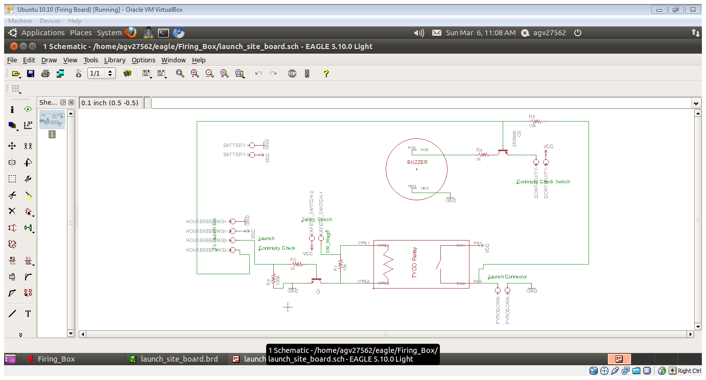
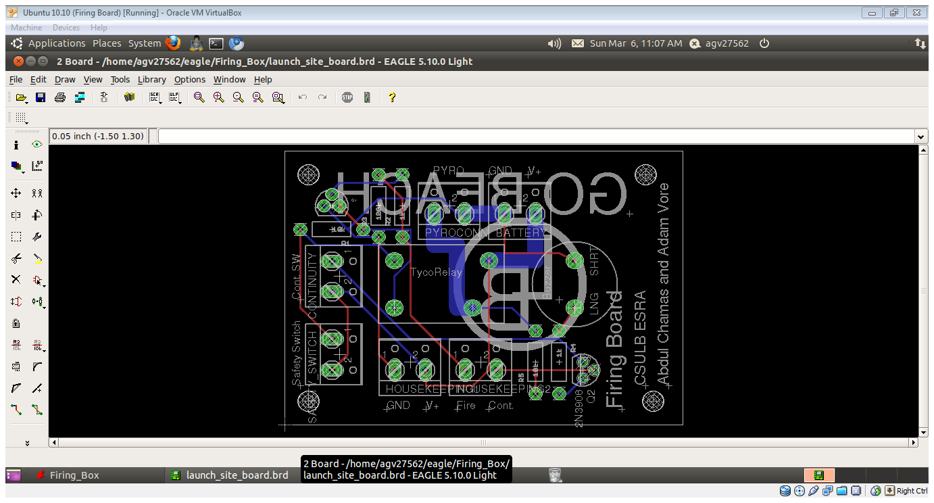
Circuit Diagram & Circuit Board

Slide 11
Conclusions & Future Work

Slide 13
Acknowledgments

